Slide 1

SUMMATIVE ORAL PRESENTATION FOR PROBLEM A (ETCEMBLY LTD) GROUP NO - 4
DATA SCIENCE MINI PROJECT 2024
SHALOMI FERNANDES,
JIADONG XU,
FANGNAN WEI,
JIAHUI LIU.

Slide 2
PRE-PROCESSING STEPS(1-2 slides):
TO BE ADDED BY JIAHUI AND TO BE EXPLAINED BY HER IN THE PRESENTATION

Slide 3
ENCODING METHODS USED:
WRITE ABOUT ONE-HOT, BLOSUM 62 AND GIANA ENCODING USE ABOUT 2 SLIDES – TO BE ADDED BY JIAHUI AND TO BE EXPLAINED BY HER IN THE PRESENTATION

Slide 4
1 SLIDE ON DATA EXPLORATION INSIGHTS:
THIS WILL BE ADDED AND EXPLAINED BY ME ON THE PRESENTATION DAY

Slide 5
1 SLIDE ON TCR DISTANCE CALCULATION
TCR DISTANCE CALCULATION THIS WILL BE ADDED AND EXPLAINED BY ME ON THE PRESENTATION DAY

Slide 6
1 SLIDE ON TCR LEVENSHTEIN DISTANCE CALCULATION
LEVENSHTEIN DISTANCE CALCULATION TO BE ADDED HERE AND EXPLAINED BY FANGNAN

Slide 7
LEVENSHTEIN DISTANCE CALCULATION
Principle：
The minimum number of single-character edits (insertions, deletions, or substitutions) required to convert one string into another.
Create a matrix of size (m+1) x (n+1), where m and n are the lengths of the two strings.
If the two current characters are the same (i.e. the i-th character of the first string and the j-th character of the second string), then d[i][j]=d[i−1][j−1] (no additional editing is required).
If different, choose the smallest edit distance among the three operations:
Delete: 𝑑 [i−1][j]+1
Insertion: 𝑑 [i][j−1]+1
Replacement: 𝑑 [i−1][j−1]+1
The last element of the matrix, d[m][n], contains the minimum number of edit operations required to convert the entire first string into the second string.
Advantage：
1. Simplicity and intuitiveness: The calculation of Levenshtein distance is based on three basic string operations: insertion, deletion and replacement.
2. Computational efficiency: Although calculating the entire matrix requires high time complexity, by using dynamic programming, the calculation of Levenshtein distance can achieve acceptable execution speed through appropriate optimization.
3. Wide range of applicability: This method can not only be applied to text data, but can also be extended to any data type that can be serialized.

Slide 8
ANALYSIS ON DIMENSIONALITY REDUCTION OUTCOMES USE ABOUT 1-2 SLIDES
TO BE ADDED BY JIADONG AND TO BE EXPLAINED BY HIM IN THE PRESENTATION

Slide 9
1 SLIDE ANALYSIS ON CLUSTERING RESULTS
CLUSTERING RESULTS (DBSCAN)TO BE ADDED HERE AND EXPLAINED BY JIADONG

Slide 10
1 SLIDE ANALYSIS ON CLUSTERING RESULTS
CLUSTERING RESULTS (AGGLOMERATIVE)TO BE ADDED HERE AND EXPLAINED BY FANGNAN

Slide 11
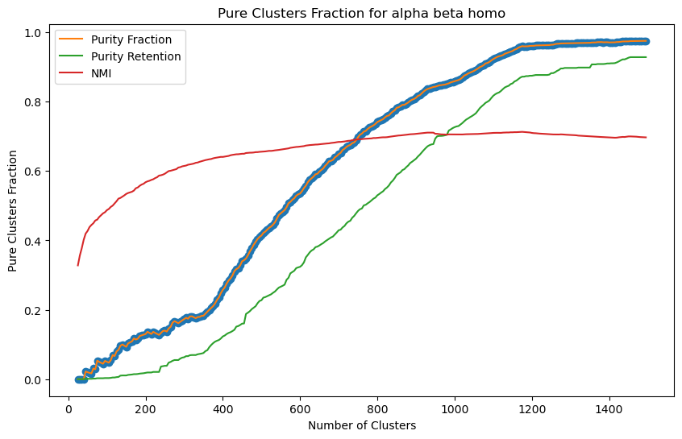
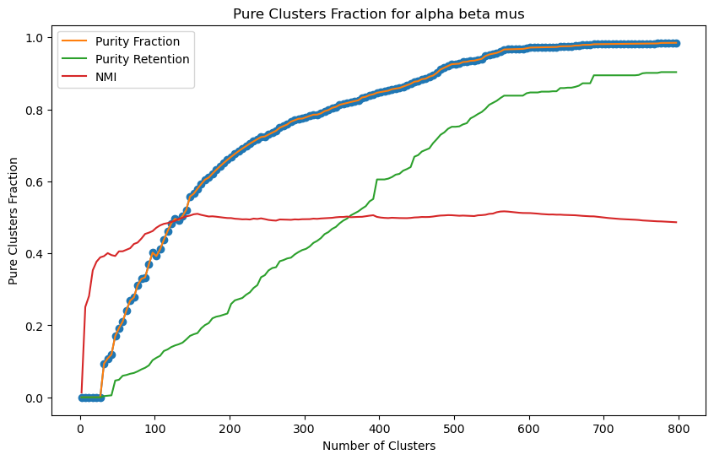
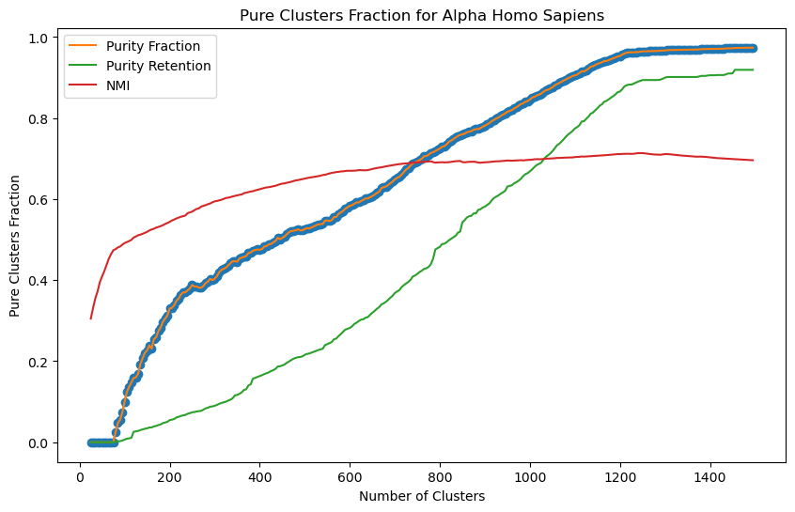
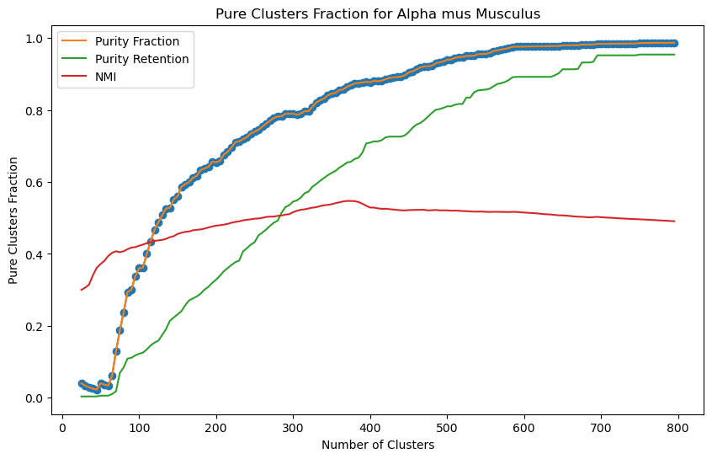
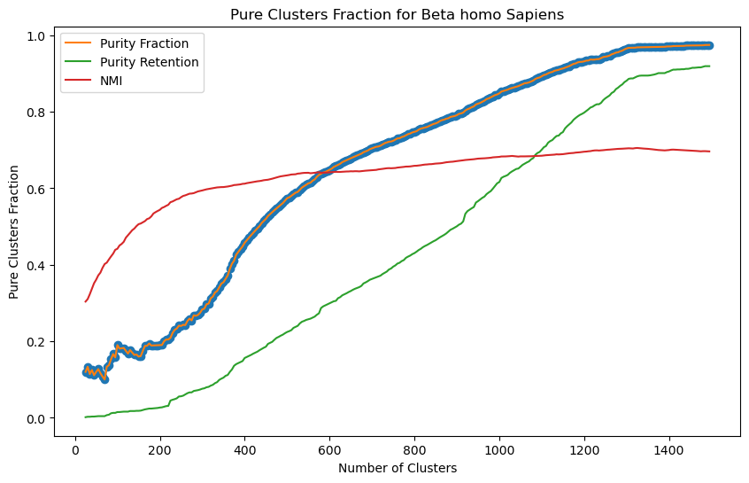
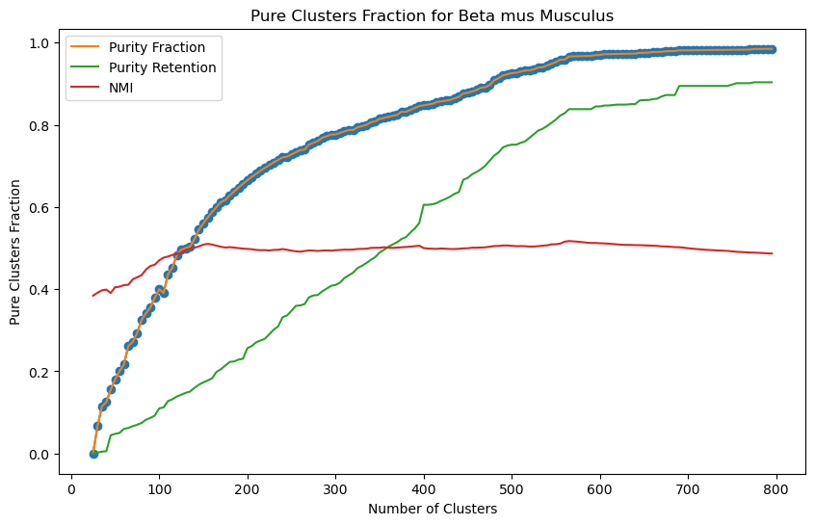
ANALYSIS ON CLUSTERING RESULTS
calculate_purity: Determine the purity of each cluster by calculating the proportion of the most common target labels in each cluster.
pure_clusters_fraction: Calculate the proportion of clusters with perfect purity (purity of 1).
pure_cluster_retention: Evaluates the proportion of samples in all data that belong to completely pure clusters.
These six figures show the impact of cluster number on Purity Fraction, Purity Retention and NMI. It can be observed that as the number of clusters increases, Purity Fraction and NMI generally show an upward trend, indicating that the refinement of clustering helps to improve the consistency of clustering and the increase of NMI. Purity Retention increases slowly in some cases because although the number of high-purity clusters increases, the proportion of samples belonging to these clusters in the overall data does not necessarily increase significantly.

Slide 12
MODEL CREATION AND OUTCOMES 1-2 SLIDES
WILL BE ADDED AND EXPLAINED BY ME

